Slide 1
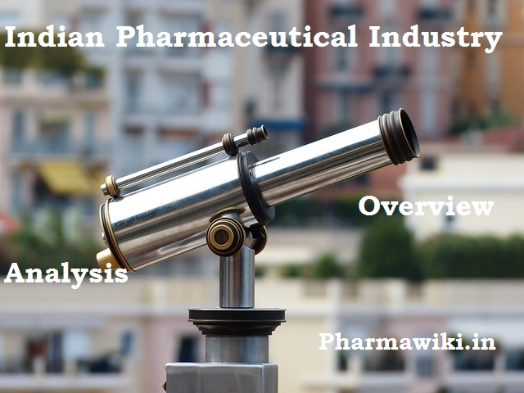

Slide 2
Important Points
The pharmaceutical industry in India ranks 3rd in the world terms of volume and 14th in terms of value.India’s cost of production is nearly 33 per cent lower than that of the US
Labour costs are 50–55 per cent cheaper than in Western countries. The cost of setting up a production plant in India is 40 per cent lower than in Western countries
Cost-efficiency continues to create opportunities for Indian companies in emerging markets & Africa
India has a skilled workforce as well as high managerial & technical competence in comparison to its peers in Asia
India has the 2nd largest number of USFDA-approved manufacturing plants outside the US
India has 2,633 FDA-approved drug products. India has over 546 USFDA-approved company sites, the highest number outside the US

Slide 3
Present Indian Pharma Industry Scenario
Expected to grow over 15 per cent per annum between 2015 and 2020
annual rate of 5 percent
The sector is expected to generate 58,000 additional job opportunities by the year 2025.
Pharmaceuticals Export Promotion Council of India (PHARMEXCIL).
India’s pharmaceutical exports stood at US$ 16.4 billion in 2016-17 and are expected to grow by 30 per cent over the next three years to reach US$ 20 billion by 2020

Slide 4
Indian companies & Approvals:
Indian companies received 55 Abbreviated New Drug Application (ANDA) approvals
16 tentative approvals from the US Food and Drug Administration (USFDA) in Q1 of 2017.
The USFDA approvals are expected to cross 700 ANDA in 2017, thereby recording a year-on-year growth of 17 per cent.
The country accounts for around 30 per cent (by volume) and about 10 per cent (value) in the US$ 70-80 billion US generics market.

Slide 5
Indian Pharma Industry Investments:
The Union Cabinet has given its nod for the amendment of the existing Foreign Direct Investment (FDI) policy in the pharmaceutical sector in order to allow FDI up to 100 per cent under the automatic route for manufacturing of medical devices subject to certain conditions.
The drugs and pharmaceuticals sector attracted cumulative FDI inflows worth US$ 14.71 billion between April 2000 and March 2017, according to data released by the Department of Industrial Policy and Promotion (DIPP).

Slide 6
Major investments in Indian pharmaceutical Sector:
Indian pharmaceutical firm, Eric Lifesciences Pvt Ltd, has launched its initial public offering (IPO) worth Rs 2,000 crore (US$ 311 million) in June 2017.
Indian pharmaceutical company, Cadila Healthcare Ltd, is planning to raise Rs 1,000 crore (US$ 155 million) via a qualified institutional placement (QIP) of shares shortly.
Capital International Group, a private equity fund, has acquired a three per cent stake in Intas Pharmaceuticals Ltd from ChrysCapital Llc for a consideration of US$ 107 million, thereby valuing Intas Pharma at approximatively US$ 3.5 billion.

Slide 7
Aurobindo Pharma Ltd, has acquired four biosimilar products from Swiss firm TL Biopharmaceutical AG, which will require TL Biopharmaceutical to supply all the developmental data for four molecules, which will be developed, commercialised and marketed by Aurobindo Pharma. Aurobindo Pharma has bought Portugal based Generis Farmaceutica SA, a generic drug company, for EUR 135 million (US$ 144 million).
Piramal Enterprises Ltd acquired a portfolio of spasticity and pain management drugs from UK-based specialty biopharmaceutical company Mallinckrodt Pharmaceuticals, in an all-cash deal for Rs1,160 crore (US$ 171 million).

